Slide 1
Software Engineering
Tatenda Gorimbo

Slide 2

Mental Health Care Mastery LTD
As a software engineer I would like to create a Mental Health Care Mastery website to make it easy for the clients to book for health practitioners.
The system must contain booking appointment option:
The client must be able to sign in and out with his/her details.
The client must be able to reset passwords.
The client must able to make an appointment from 9a.m to 7p.m
The system must be flexible to use in different devices and operating systems such as windows, macOS , Androids and Linux etc.
The client must be able to access the contact details of the company

Slide 3
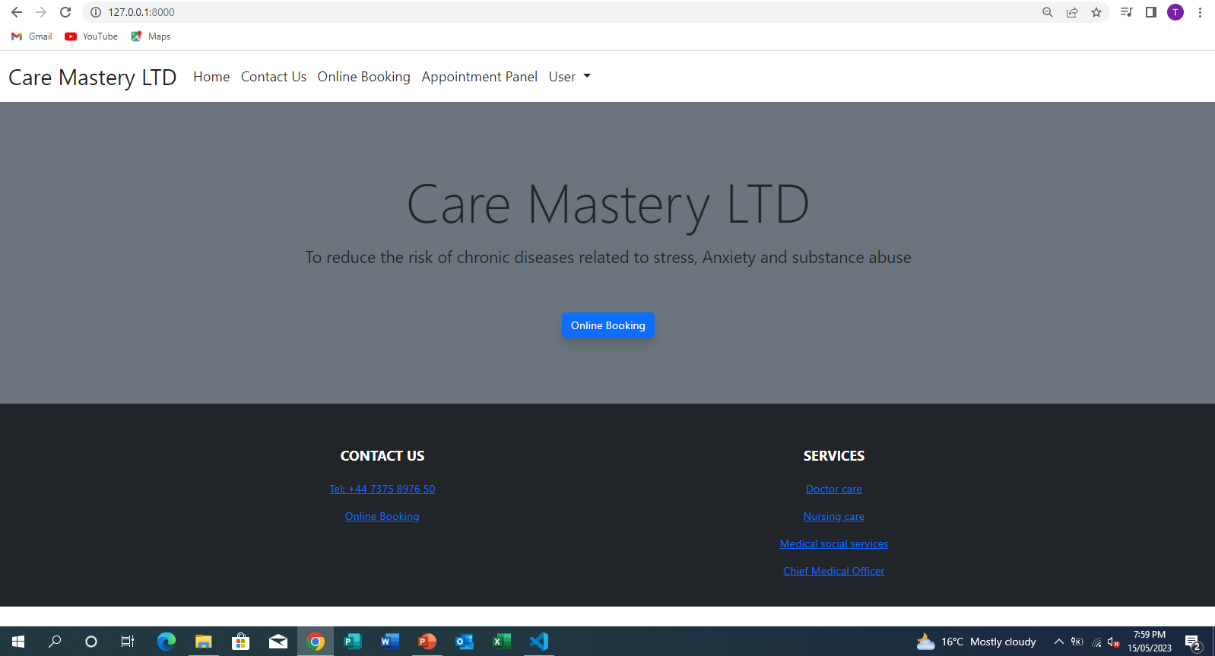
HOME PAGE
Our home page shows :
Name of the company
The motto of the company
Online booking option
Contact us details
Our Services which shows the health practitioners that works for the company
It also shows the other pages such as online booking, appointment panel and user

Slide 4
Requirements Specification
ONLINE BOOKING OPTION:
If you click on online booking it will take you to the page where you can select the type of service you want to book for.
It will also gives you the available dates that you can make the appointment.
When you click continue it will take you to a page where you can select available time for the appointment.
Then as soon as you submit the appointment will be automatically saved.
APPOINTMENT PANEL OPTION:
When you select appointment panel it will immediately take you to the list of the appointment that have been made .
It also have the search appointment option where you can be able to search for the appointment that you have made in case there might be a lot of appointment that have been made before
USER PANEL
It show the information of the person who has booked (user information)
It shows the appointment information and there's and an edit option in case you might want to change the time or date of the appointment.
Then after you are done with editing there's sign out option

Slide 5

MY PRESENTATION VIDEO

Slide 6
Implementation

Slide 7
Testing
Description | Data | Expected | Actual | Changes made

